Slide 1

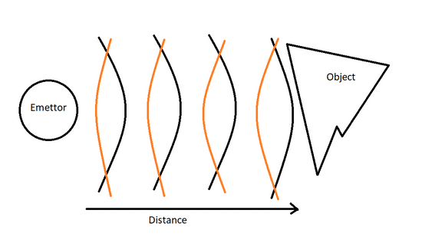


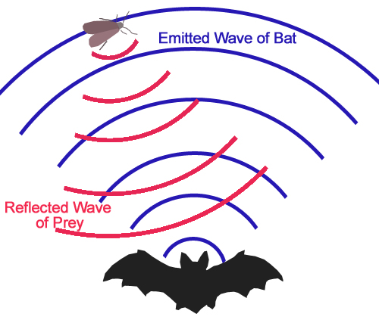
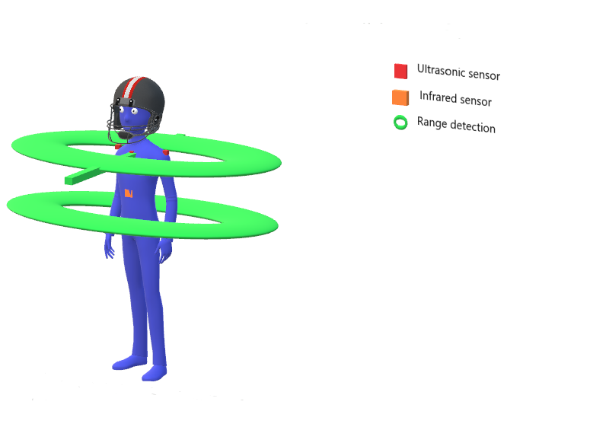
BlindSight
By Liam MARTIN-ESCOFFIER
BlindSight is my 4th year college project.
It is a Smart Jacket with a built in system to help users, who are blind or with vision impairment, avoid obstacles when moving around.
This project was made to facilitate the life of visually-impaired people and help them in their ordinary life.
I have based my research on Biomimicry, “Biomimicry is the imitation of the systems of nature for the purpose of solving complex human problems.”
This project was made under Python with the use of an Arduino Uno Mega
and a Raspberry Pi 4.
The Avoidance system use Ultrasonic sensor to determine if an object is under a threshold distance and if so alert the user
&
My plan is to develop an even better version with the intent to sell it to a health care so it can be produced on a larger scale, and be use for the highest number of people possible

